Slide 1
BCS1520: Statistics
Lecture 06:
Probability meets Statistics PART 2

Slide 2
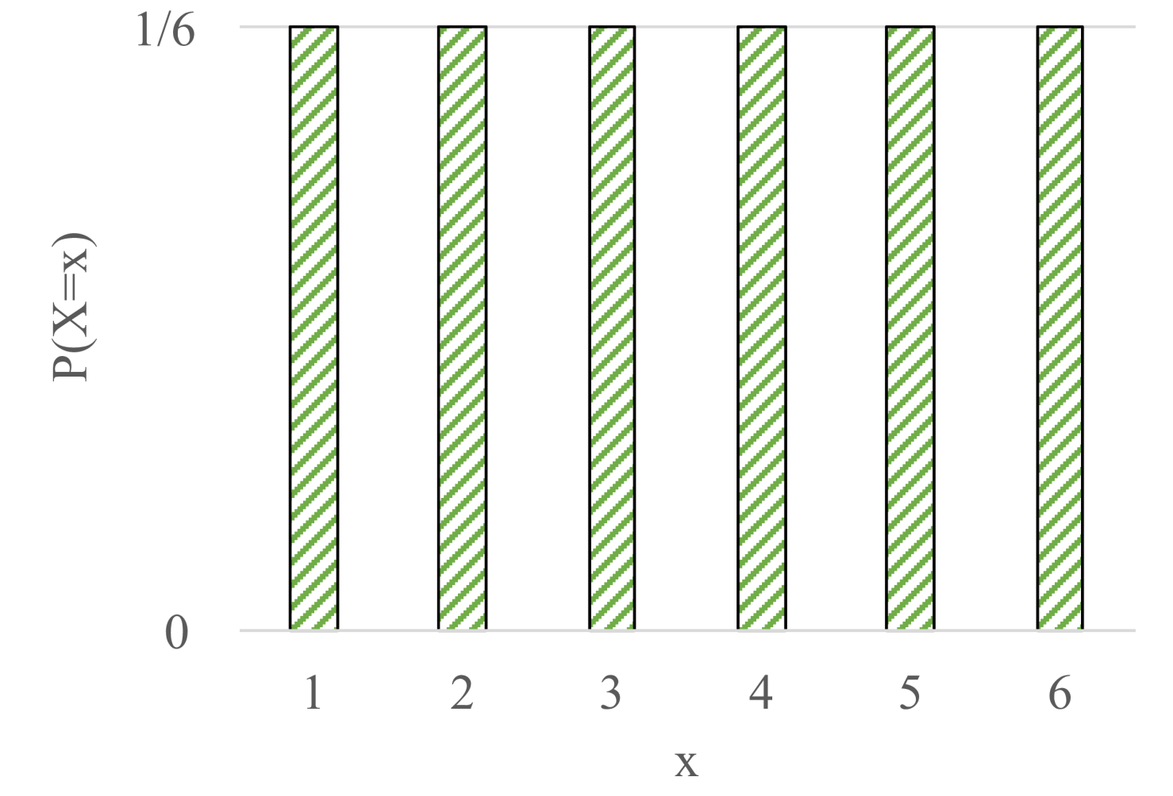
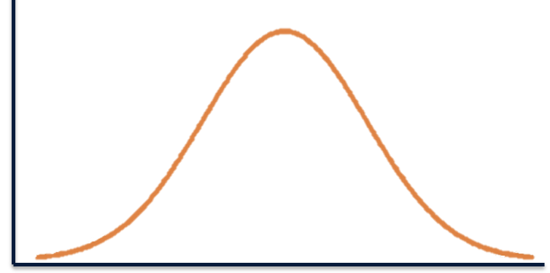
Recap: Random Variables
Discrete
Probability Mass Function (PMF): p(x)
Probability that X is exactly x
Sum of all bars = 1
y-axis: probability
Continuous
Probability Density Function (PDF): f(x)
Density at point x
Area under the curve = 1
Y-axis: density (area is probability)
One dice roll
Notes:
PDF: finding probability of a range (area under the curve), e.g. [2.00000, 2.000001], never exact point. Probability of exact x = 0.
You integrate to find the area under the curve.

Slide 3
Recap: Continuous Random Variables
Probability Density Function (pdf): f(x)
Not an exact point,
but an interval [a,b]
a
b

Slide 4
Recap: Continuous Random Variables
Probability Density Function (pdf): f(x)
Cumulative Distribution: F(x)
b

Slide 5
Recap
Expectation, E[X]
Variance, var(X)
Covariance, cov(X)

Slide 6
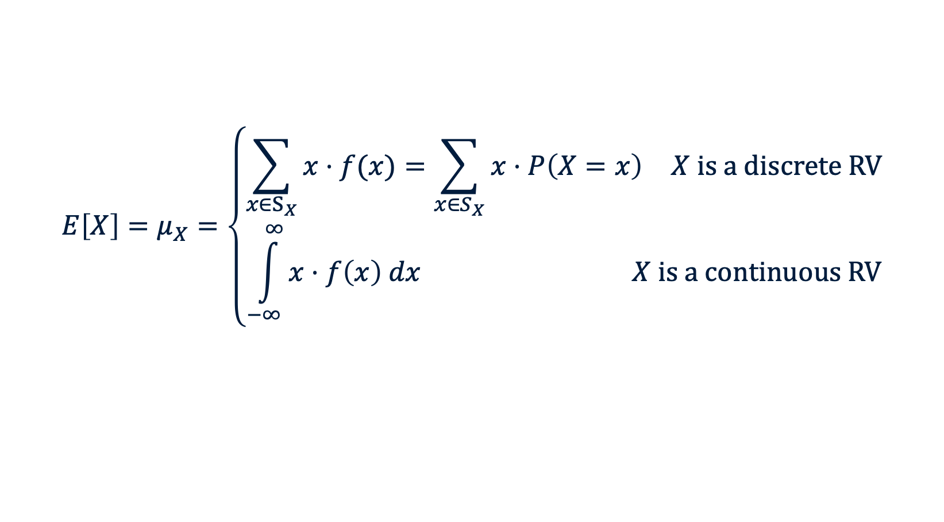
Recap
Expectation, E[X]
Variance, var(X)
Covariance, cov(X)
$$E\left[X\right]=μ_{X}=\left\{\begin{aligned}\begin{matrix}\sum_{x∈S_{X}}{x⋅f(x)}=\sum_{x∈S_{X}}{x⋅P\left(X=x\right)} & X is a discrete RV\end{matrix} \\ \begin{matrix}\int_{−∞}^{∞}{x⋅f\left(x\right) dx} & X is a continuous RV\end{matrix}\end{aligned}\right.$$

Slide 7

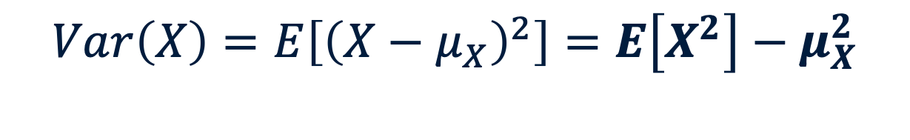
Recap
Expectation, E[X]
Variance, var(X)
Covariance, cov(X)
$$Var\left(X\right)=E\left[{\left(X−μ_{X}\right)}^{2}\right]=E\left[X^{2}\right]−μ_{X}^{2}$$
with $μ_{X}=E\left[X\right]$

Slide 8

Recap
Expectation, E[X]
Variance, var(X)
Covariance, cov(X)
$$Cov\left(X,Y\right)=E\left[XY\right]−μ_{X}μ_{Y}$$
with $μ_{X}=E\left[X\right]$

Slide 9
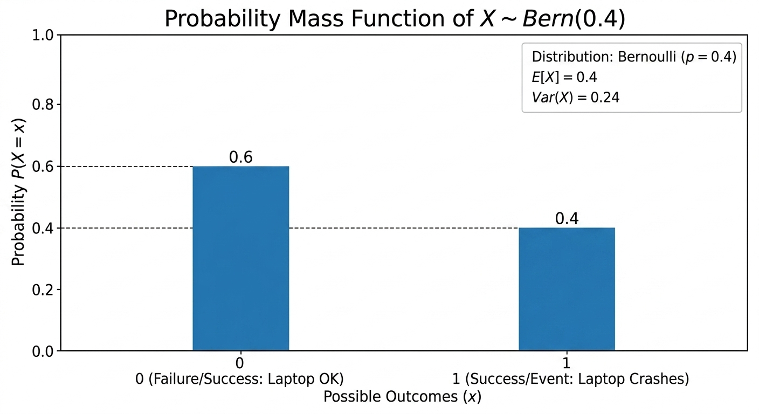
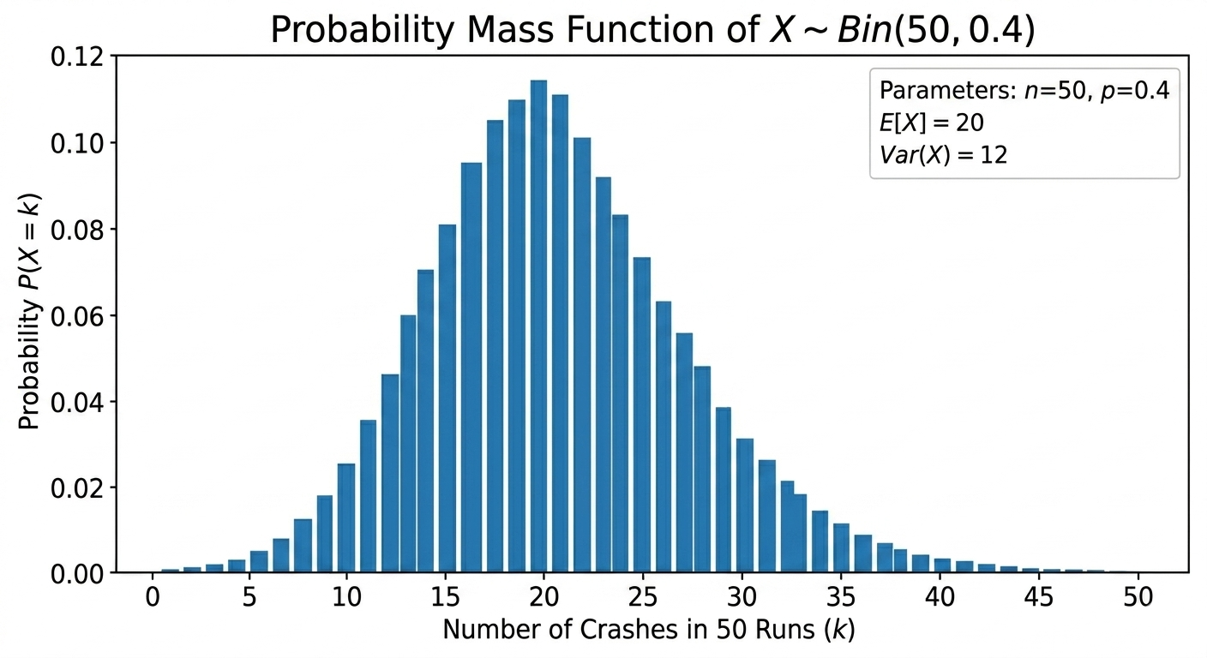
Recap
Bernouilli:
"I just wrote a risky script. I press run. Does my laptop crash?"
Single trial
Multiple
trials
Binomial:
"Was that crash a fluke? I’m going to run the script 50 times in a row to be sure."
Notes:
But once we know that we can use a distribution, our life gets much easier.

Slide 10
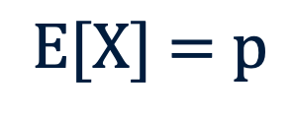

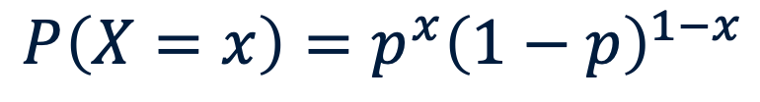
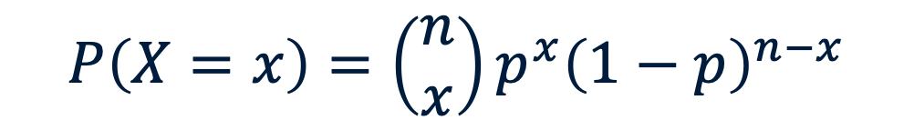
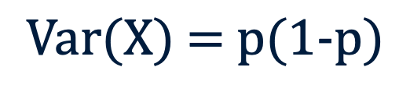
Recap
Bernoulli
Binomial
“Will my laptop crash 10 times out of 50 trials?”
“Does my laptop crash?”
$$P\left(X=x\right)=\left(\begin{matrix}n \\ x\end{matrix}\right)p^{x}{\left(1−p\right)}^{n−x}$$
$$P\left(X=x\right)=p^{x}{\left(1−p\right)}^{1−x}$$
$$\text{E}\text{[}\text{X}\text{] = }\text{p}$$
$$E\left[X\right]=np$$
$$Var\left(X\right)=np\left(1−p\right)$$
$$\text{Var}\text{(}\text{X}\text{) = }\text{p}\text{(1−}\text{p}\text{)}$$

Slide 11
Distribution overview
Bernouilli:
"I just wrote a risky script. I press run. Does my laptop crash?"
Single trial
Multiple
trials
Binomial:
"Was that crash a fluke? I’m going to run the script 50 times in a row to be sure."
YOU ARE HERE
Poisson:
"I’m a workaholic; my code runs 24/7. It could crash at any millisecond. How many times will it fail tomorrow?"
Over time
The BIG
picture
Normal:
”I am running this on a thousand laptops 24/7. What is the total downtime due to crashes?"

Slide 12
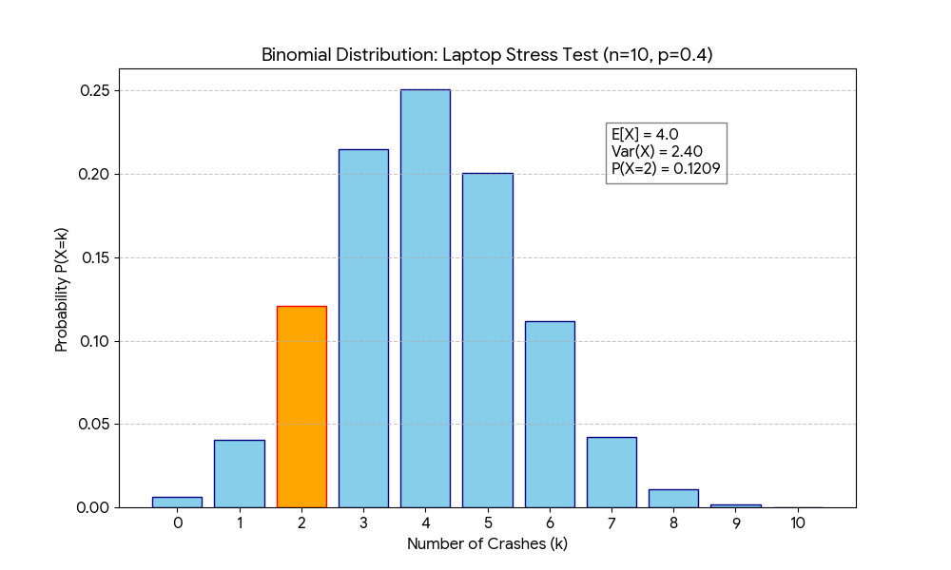
My Laptop & the Binomial Distribution
n=10
Notes:
We were in control of n, a set number of trials. But what if our n gets extremely large? Our calculations become difficult.
What if I leave my laptop on for week? What if we run for every millisecond?

Slide 13
From Binomial to Poisson
We were in control of the number of trials (n)
If that number goes toward infinity, we get poisson
Mostly used for fixed time intervals
Notes:
Mostly used for fixed time intervals, but theoretically could be extended for any fixed time or space interval with rare events

Slide 14
From Binomial to Poisson: intuition of time
Binomial: n=10, p=0.4 -> 10 * 0.4 = 4
4 crashes in 10 days
N = 10 (10 days), p=0.40
N = 240 (10 * 24 hours), p=0.0167
N = 14000 (10 * 24 * 60 minutes), p = 0.000278
N = 864000 (10 * 24 * 60 * 60 seconds), p=0.00000463
Notes:
Mostly used for fixed time intervals, but theoretically could be extended for any fixed time or space interval with rare events

Slide 15
From Binomial to Poisson: intuition of time
Binomial: n=10, p=0.4 -> 10 * 0.4 = 4
4 crashes in 10 days
N = 10 (10 days), p=0.40
N = 240 (10 * 24 hours), p=0.0167
N = 14000 (10 * 24 * 60 minutes), p = 0.000278
N = 864000 (10 * 24 * 60 * 60 seconds), p=0.00000463
As interval becomes smaller, probability per interval decreases as well
Towards infinity

Slide 16
From Binomial to Poisson: intuition of time
Binomial: n=10, p=0.4 -> 10 * 0.4 = 4
4 crashes in 10 days
What remains constant? The number of crashes per 10 days, regardless of n or p.
λ = 4
Lambda is our parameter for Poisson

Slide 17
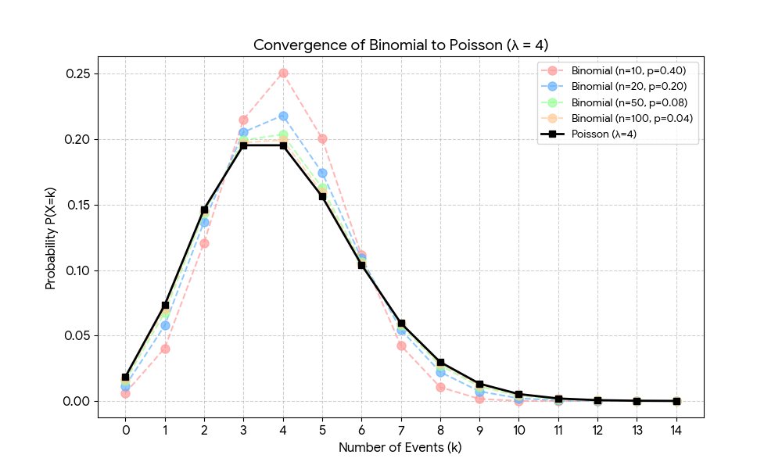
From Binomial to Poisson
Notes:
N to 10, 20, 50 and 100. As you see, binomial converges towards poisson

Slide 18

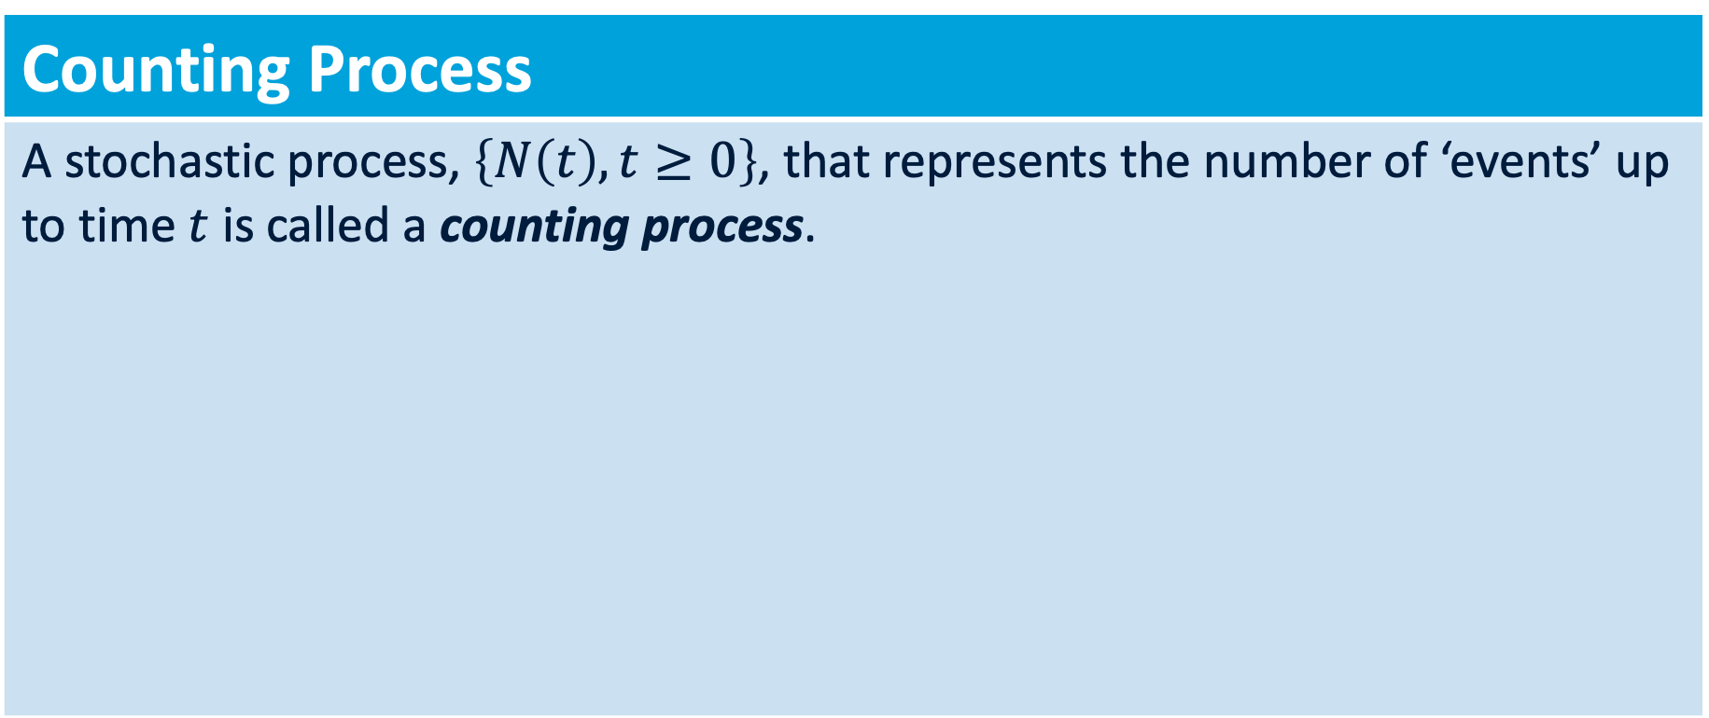



Poisson: Counting
Counting Process
A stochastic process, $\left\{N\left(t\right), t≥0\right\}$, that represents the number of ‘events’ up to time $t$ is called a counting process.
$$0$$
$$t$$
$$N\left(t\right)=4$$
Notes:
The intuition of poisson begins with a counting process (like a stopwatch). We count the crashes during a continuous time laps
A counting process is not necessary to recognize poisson, but it explains the intuition. We simply count rare occurences over time and poisson helps us in deriving the probability of a number of events happening

Slide 19
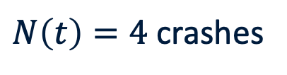

In the real world: Poisson Process
Counting Process
A stochastic process, $\left\{N\left(t\right), t≥0\right\}$, that represents the number of ‘events’ up to time $t$ is called a counting process.
$$0$$
$$10 days$$
The counting process N(t) counts how many crashes have accumulated by time t.
$N\left(t\right)=4$ crashes
Notes:
This helps us towards poisson.

Slide 20

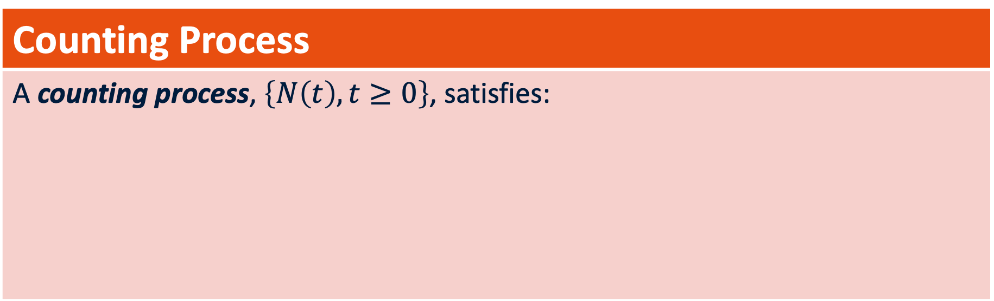



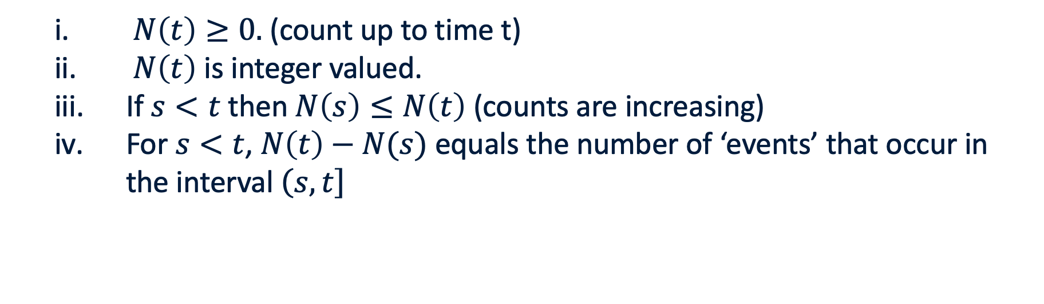
Poisson: Counting
Counting Process
A counting process, $\left\{N\left(t\right), t≥0\right\}$, satisfies:
$N\left(t\right)≥0.$ (count up to time t)
$N\left(t\right)$ is integer valued.
If $s<t$ then $N\left(s\right)≤N\left(t\right)$ (counts are increasing)
For $s<t$, $N\left(t\right)−N(s)$ equals the number of ‘events’ that occur in the interval $\left(\left.s,t\right]\right.$
$$N\left(t\right)$$
$$0$$
$$t$$
$$10 Days$$

Slide 21







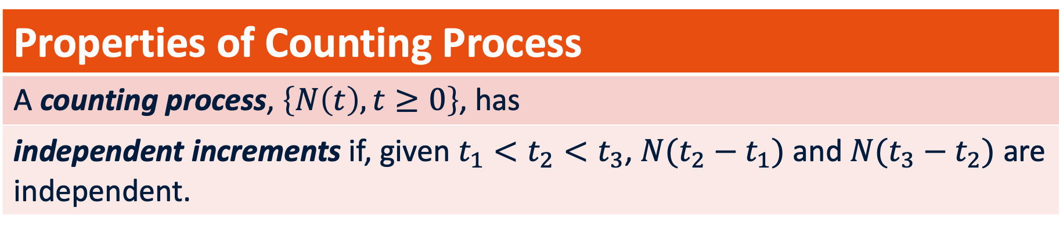
Poisson Process & Distribution
Properties of Counting Process
A counting process, $\left\{N\left(t\right), t≥0\right\}$, has
independent increments if, given $t_{1}<t_{2}<t_{3}$, $N({t_{2}−t}_{1})$ and $N({t_{3}−t}_{2})$ are independent.
$$N\left(t_{2}−t_{1}\right)$$
$$t_{1}$$
$$t_{2}$$
$$t_{3}$$
$$0$$
$$t$$
$$N\left(t_{3}−t_{2}\right)$$

Slide 22


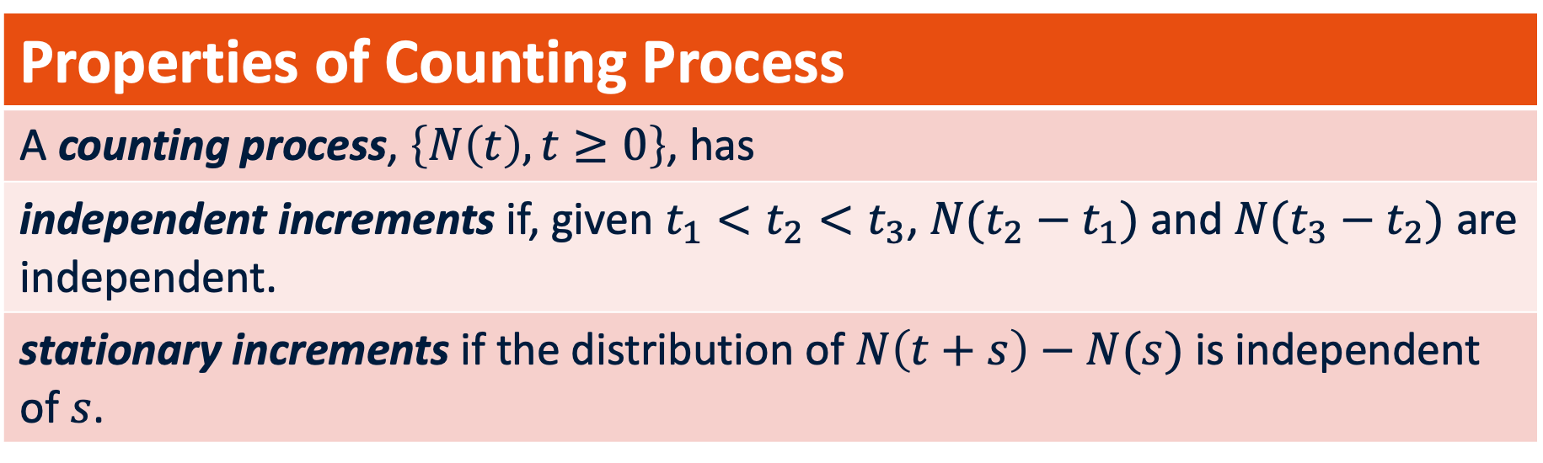




Poisson Process & Distribution
Properties of Counting Process
A counting process, $\left\{N\left(t\right), t≥0\right\}$, has
independent increments if, given $t_{1}<t_{2}<t_{3}$, $N({t_{2}−t}_{1})$ and $N({t_{3}−t}_{2})$ are independent.
stationary increments if the distribution of $N\left(t+s\right)−N(s)$ is independent of $s$.
$$N\left(t+s\right)−N\left(s\right)$$
$$s$$
$$s′$$
$$t+s$$
$$t+s′$$
$$0$$
$$N\left(t+s′\right)−N\left(s′\right)$$

Slide 23
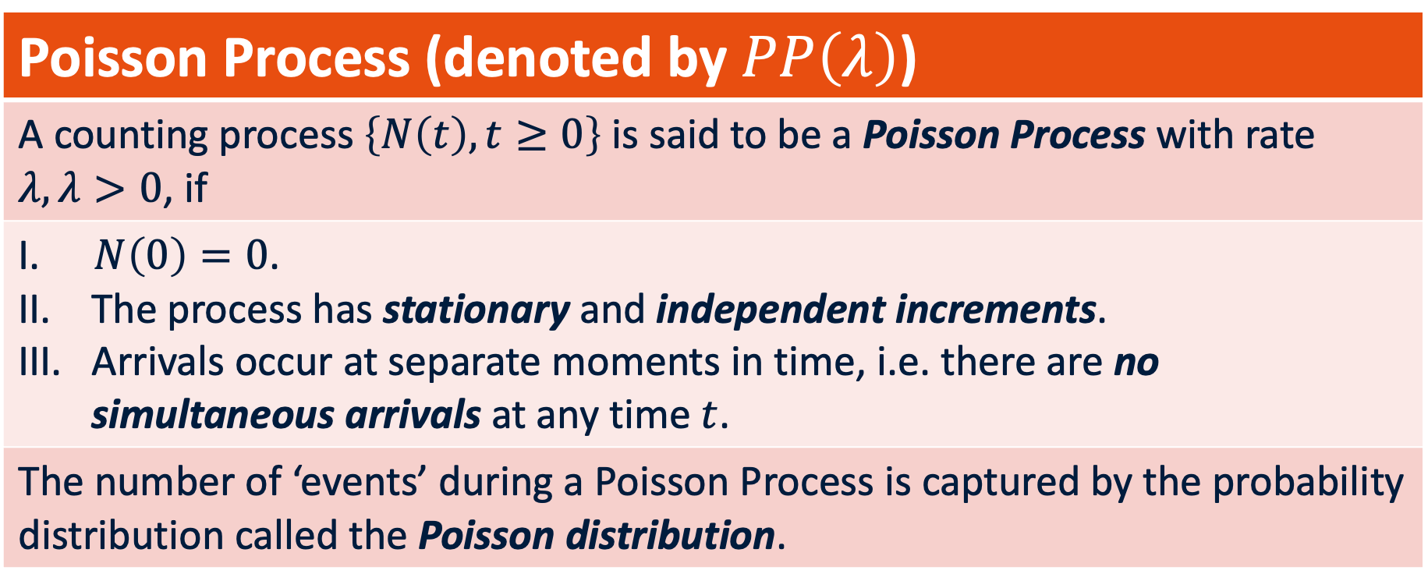
Poisson Process & Distribution
Poisson Process (denoted by $PP\left(λ\right)$)
A counting process $\left\{N\left(t\right), t≥0\right\}$ is said to be a Poisson Process with rate $λ,λ>0$, if
$N\left(0\right)=0$. The process has stationary and independent increments. Arrivals occur at separate moments in time, i.e. there are no simultaneous arrivals at any time $t$.
The number of ‘events’ during a Poisson Process is captured by the probability distribution called the Poisson distribution.

Slide 24
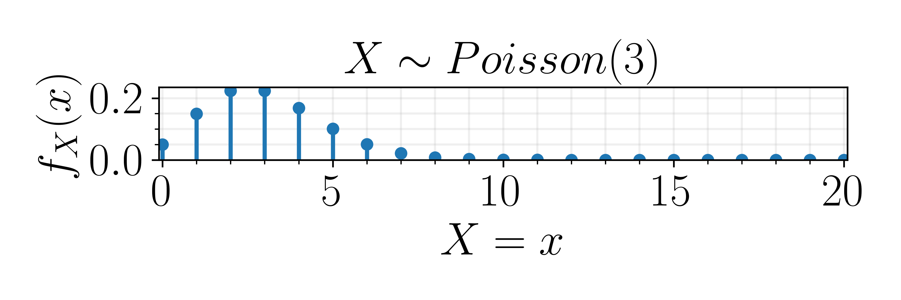
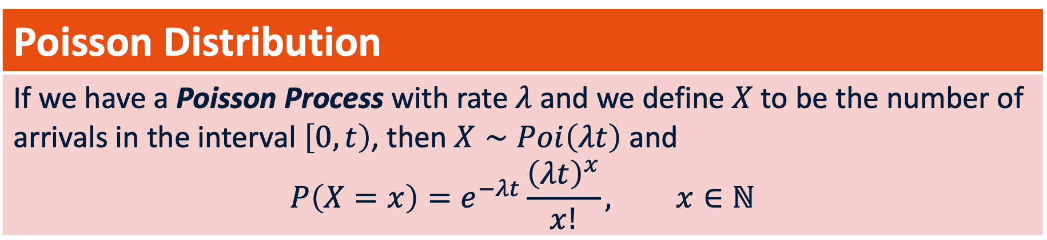

Poisson Process & Distribution
Poisson Distribution
If we have a Poisson Process with rate $λ$ and we define $X$ to be the number of arrivals in the interval $\left[0,t\right)$, then $X∼Poi\left(λt\right)$ and $$P\left(X=x\right)=e^{−λt}\frac{{\left(λt\right)}^{x}}{x!}, x∈ℕ$$
Descriptive statistics: $X∼Poi\left(λt\right)$
$$E\left[X\right]=λt, Var\left(X\right)=λt$$

Slide 25

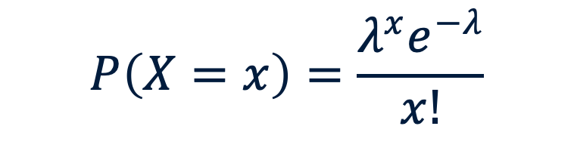

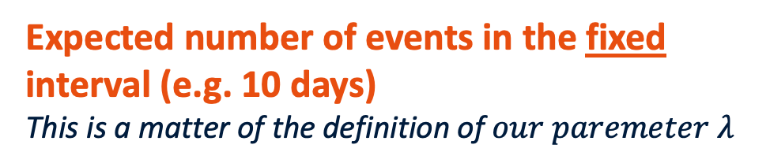
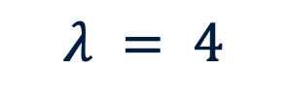

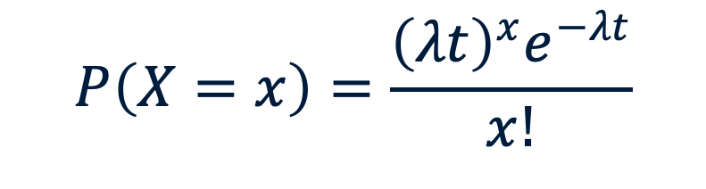
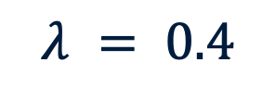
We use t so time can change! (Mind the definition)
$$P\left(X=x\right)=\frac{λ^{x}e^{−λ}}{x!}$$
$$P\left(X=x\right)=\frac{{\left(λt\right)}^{x}e^{−λt}}{x!}$$
$$λ = 4$$
$$λ = 0.4$$
Expected number of events in the fixed interval (e.g. 10 days)
This is a matter of the definition of $our paremeter λ$
$λ$ is the rate (e.g. per day), t is the time
This is a matter of the definition of $our paremeter λ$
$$E\left[X\right]=λ$$
$$E\left[X\right]=λt$$
Notes:
Left side is often used for poisson. But in this way, lambda is set and we only study a single time interval. When we account for t directly and use lambda as rate, we can directly change the time

Slide 26
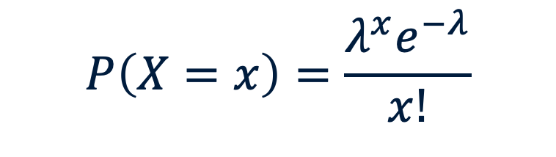


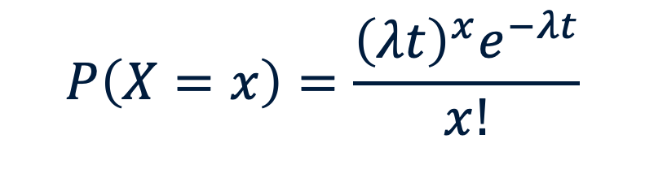
We use t so time can change! (Mind the definition)
$$P\left(X=x\right)=\frac{λ^{x}e^{−λ}}{x!}$$
$$P\left(X=x\right)=\frac{{\left(λt\right)}^{x}e^{−λt}}{x!}$$
$$λ = 4$$
$$λ = 0.4$$
Expected number of events in the fixed interval (e.g. 10 days)
This is a matter of the definition of $our parameter λ$
$λ$ is the rate (e.g. per day), t is the time
This is a matter of the definition of $our parameter λ$
$$E\left[X\right]=λ$$
$$E\left[X\right]=λt$$
Notes:
Left side is often used for poisson. But in this way, lambda is set and we only study a single time interval. When we account for t directly and use lambda as rate, we can directly change the time

Slide 27
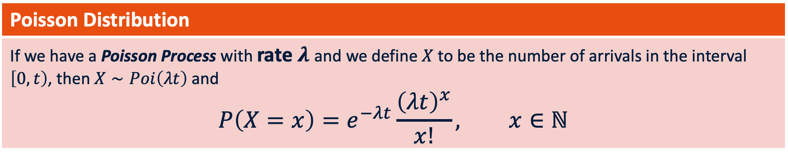
Poisson: quick overview
Poisson Distribution
If we have a Poisson Process with rate $λ$ and we define $X$ to be the number of arrivals in the interval $\left[0,t\right)$, then $X∼Poi\left(λt\right)$ and $$P\left(X=x\right)=e^{−λt}\frac{{\left(λt\right)}^{x}}{x!}, x∈ℕ$$
We are still using discrete RV’s
Events are independent
Evants happen at a constant average rate
$$E\left[X\right]=λt, Var\left(X\right)=λt$$

Slide 28


Poisson: Example
For the sake of this example, we convert 4 crashes in 10 days to a rate $λ=0.4$(per day).
Descriptive statistics: $X∼Poi\left(λt\right)$
$$E\left[X\right]=λt, Var\left(X\right)=λt$$

Slide 29
Poisson: Example
For the sake of this example, we convert 4 crashes in 10 days to a rate $λ=0.4$(per day).
Descriptive statistics: $X∼Poi\left(λt\right)$
$$E\left[X\right]=λt, Var\left(X\right)=λt$$
t = 10 -> E[X] = 0.40 * 10 = 4
t = 25 -> E[X] = 0.40 * 25 = 10

Slide 30


Poisson: example
$$P\left(X=x\right)=e^{−λt}\frac{{\left(λt\right)}^{x}}{x!}$$
What is the probability of my laptop crashing twice tomorrow?
t?
$λ$?
x?

Slide 31
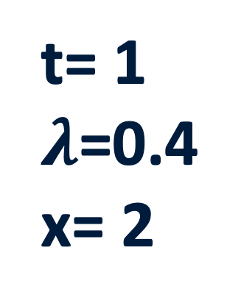
Poisson: example
$$P\left(X=x\right)=e^{−λt}\frac{{\left(λt\right)}^{x}}{x!}$$
What is the probability of my laptop crashing twice tomorrow?
t= 1
$λ$=0.4
x= 2
Tomorrow is one day
Our rate is constant
Laptop crashing twice

Slide 32
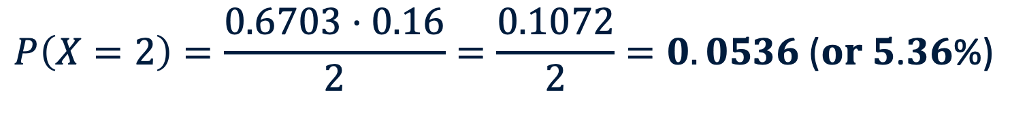
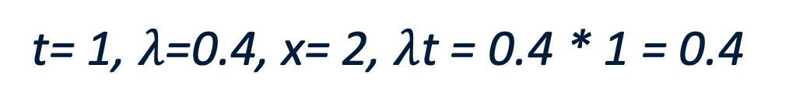
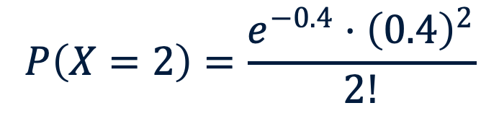
Poisson: example
$$P\left(X=x\right)=e^{−λt}\frac{{\left(λt\right)}^{x}}{x!}$$
What is the probability of my laptop crashing twice tomorrow?
t= 1, $λ$=0.4, x= 2, $λ$t = 0.4 * 1 = 0.4
$$P\left(X=2\right)=\frac{e^{−0.4}⋅{\left(0.4\right)}^{2}}{2!}$$
$$P\left(X=2\right)=\frac{0.6703⋅0.16}{2}=\frac{0.1072}{2}=0.0536\text{ (}\text{or} \text{5}\text{.}\text{36}\text{\%)}$$
Notes:
T = 1 so cancelled out in the multiplication

Slide 33
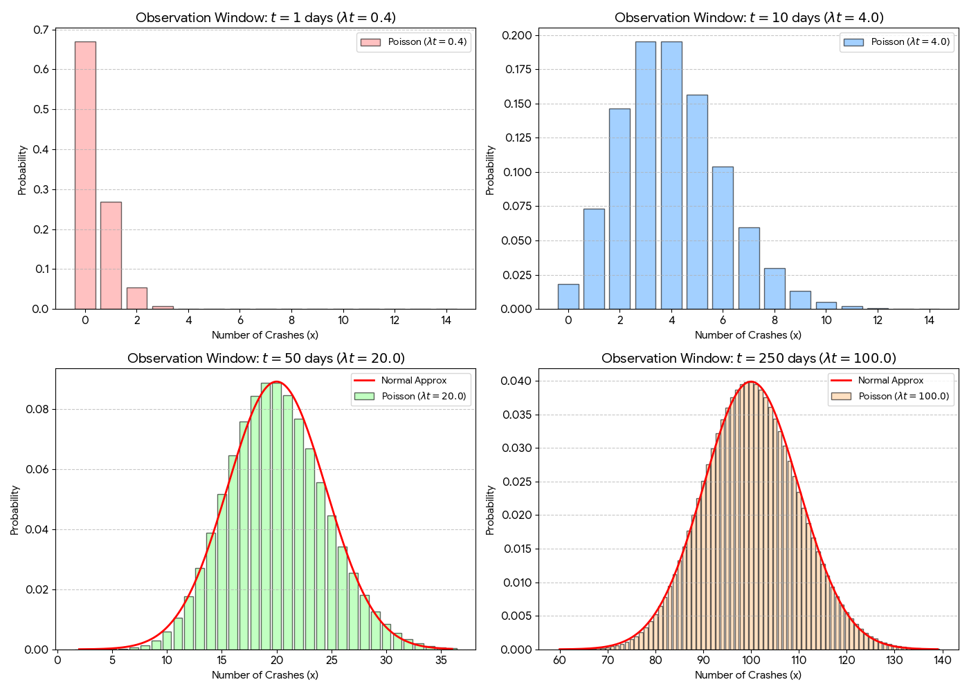
This is where we were on the last slide!
Notes:
FROM POISSON TO NORMAL
We see our lambda * t change. From 0.4 for 1 day to 100 for 250 days. Remember that the rate (lambda itself) remains constant at 0.4. Only t increases

Slide 34
As our time window expands, a bell shape starts to form
Symmetry starts to appear
Normal
Notes:
FROM POISSON TO NORMAL
We see our lambda * t change. From 0.4 for 1 day to 100 for 250 days. Remember that the rate (lambda itself) remains constant at 0.4. Only t increases

Slide 35
We see why this happens later!
Normal
Notes:
FROM POISSON TO NORMAL
We see our lambda * t change. From 0.4 for 1 day to 100 for 250 days. Remember that the rate (lambda itself) remains constant at 0.4. Only t increases

Slide 36
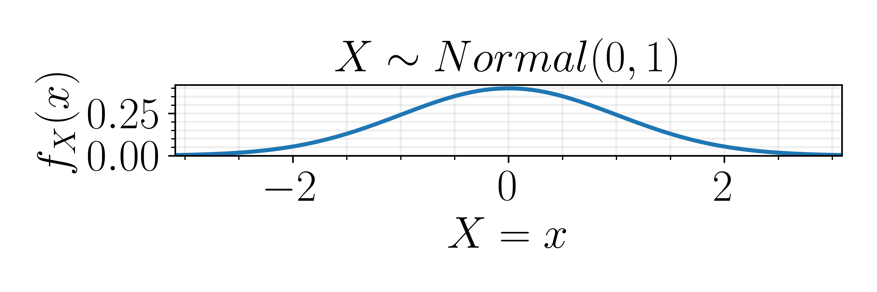
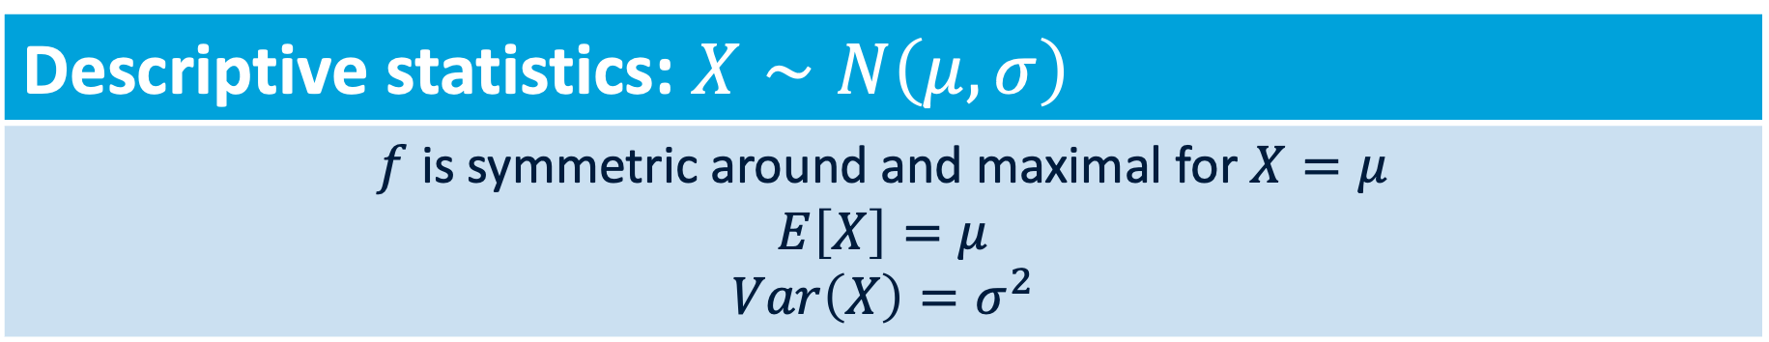
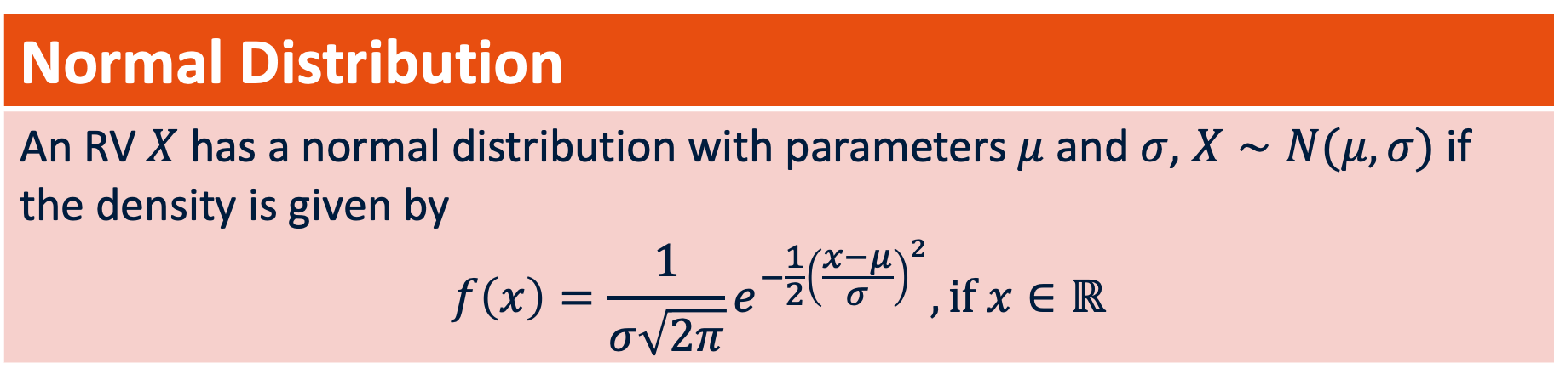
Normal distribution
Normal Distribution
An RV $X$ has a normal distribution with parameters $μ$ and $σ$, $X∼N(μ,σ)$ if the density is given by $$f\left(x\right)=\frac{1}{σ\sqrt{2π}}e^{−\frac{1}{2}{\left(\frac{x−μ}{σ}\right)}^{2}}, if x∈ℝ$$
Descriptive statistics: $X∼N\left(μ,σ\right)$
$f$ is symmetric around and maximal for $X=μ$ $$E\left[X\right]=μ$$ $$Var\left(X\right)=σ^{2}$$
Notes:
Maximal for X = mu means that the top of the bell curve is the highest point and is the mean

Slide 37

Just a normal formula
$$f\left(x\right)=\frac{1}{σ\sqrt{2π}}e^{−\frac{1}{2}{\left(\frac{x−μ}{σ}\right)}^{2}}$$

Slide 38

Just a normal formula
$$f\left(x\right)=\frac{1}{σ\sqrt{2π}}e^{−\frac{1}{2}{\left(\frac{x−μ}{σ}\right)}^{2}}$$
If not =1, not a probability function!
$$\frac{1}{σ\sqrt{2π}}$$
Scales the bell curve so that area under the curve always = 1

Slide 39
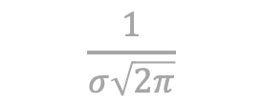

Just a normal formula
$$f\left(x\right)=\frac{1}{σ\sqrt{2π}}e^{−\frac{1}{2}{\left(\frac{x−μ}{σ}\right)}^{2}}$$
If not =1, not a probability function!
$$\frac{1}{σ\sqrt{2π}}$$
Scales the bell curve so that area under the curve always = 1
The distance between x and mean
Symmetry
- Makes the bell curve trend towards 0
$$e^{−\frac{1}{2}{\left(\frac{x−μ}{σ}\right)}^{2}}$$
Spread of the curve
Natural base e: ‘natural decay’ away from mean

Slide 40
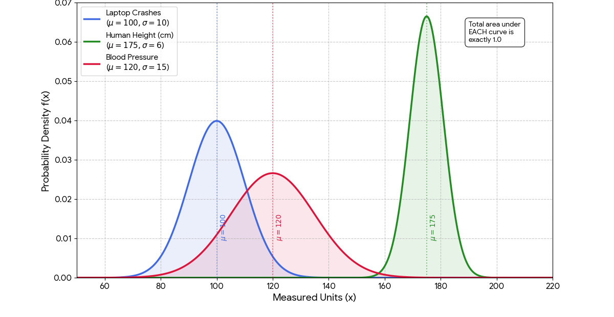
The area under the curve = 1
Notes:
WE do not need an infinute number of possible normal distributions. The area under the bell curve will always remain 1, even if we change out the parameters.
Your laptop crashes: mu=100, sigma=10
A person's height: mu=175, sigma=6
A blood pressure reading: mu=120, sigma=15

Slide 41
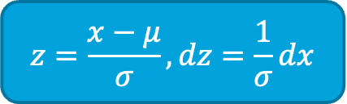
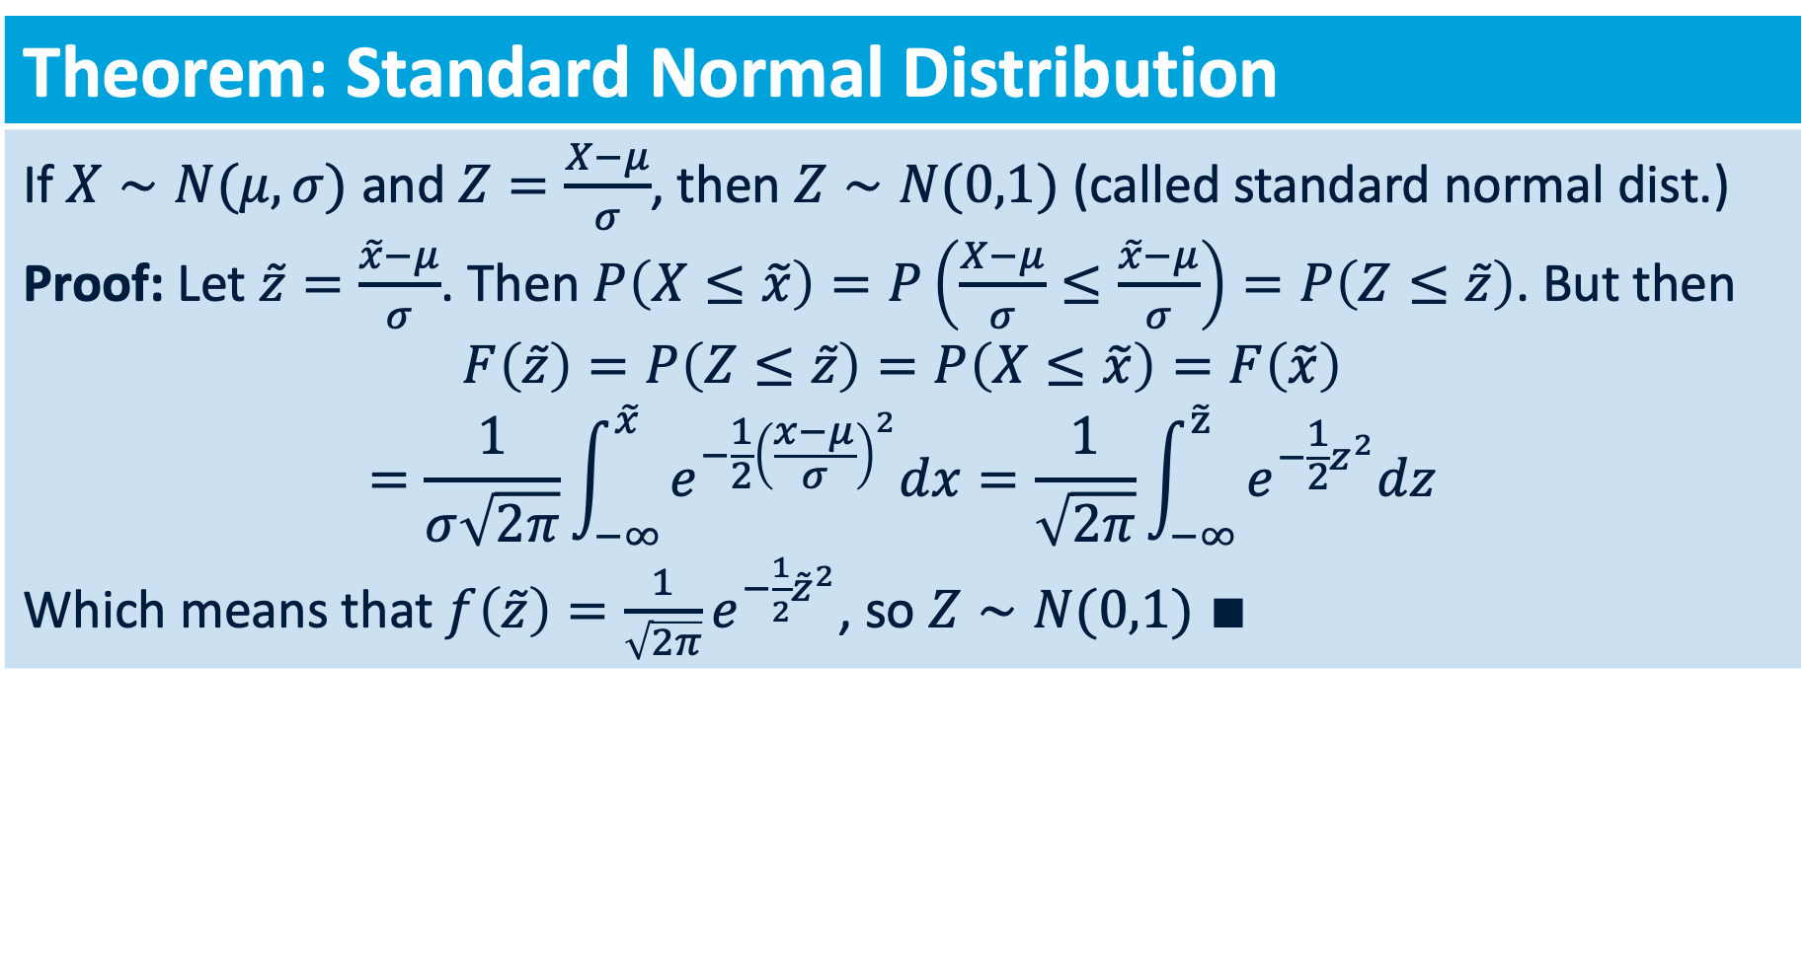
Normal distribution
Theorem: Standard Normal Distribution
If $X∼N(μ,σ)$ and $Z=\frac{X−μ}{σ}$, then $Z∼N(0,1)$ (called standard normal dist.) Proof: Let $\tilde{z}=\frac{\tilde{x}−μ}{σ}$. Then $P\left(X≤\tilde{x}\right)=P\left(\frac{X−μ}{σ}≤\frac{\tilde{x}−μ}{σ}\right)=P\left(Z≤\tilde{z}\right)$. But then $$F\left(\tilde{z}\right)=P\left(Z≤\tilde{z}\right)=P\left(X≤\tilde{x}\right)=F\left(\tilde{x}\right)$$ $$=\frac{1}{σ\sqrt{2π}}\int_{−∞}^{\tilde{x}}{e^{−\frac{1}{2}{\left(\frac{x−μ}{σ}\right)}^{2}}dx}=\frac{1}{\sqrt{2π}}\int_{−∞}^{\tilde{z}}{e^{−\frac{1}{2}z^{2}}dz}$$ Which means that $f\left(\tilde{z}\right)=\frac{1}{\sqrt{2π}}e^{−\frac{1}{2}{\tilde{z}}^{2}}$, so $Z∼N(0,1)$ $∎$
$$z=\frac{x−μ}{σ},dz=\frac{1}{σ}dx$$
Take-away: any normal distribution can be standardized into the standard normal (mean=0, stdev=1)
Notes:
subtracting the mean and dividing by the standard deviation transforms any Normal distribution into the Standard Normal (ASSUMING ORIGINAL DATA WAS ALREADY NORMAL )
Goal: if X is Normal, then Z is also Normal but with a mean of 0 and a variance of 1
CDF: The probability that our random variable X is less than some value \tilde{x} must be the same as the probability that our transformed variable Z is less than the transformed value \tilde{z}$
Standard substitution: within parentheses becomes z, 1/stdev dx becomes dz

Slide 42

Standard Normal Distribution
We can map real-world situations onto this universal template
AUC does not change when shifting or rescaling
We only need a single Z-table
$$z=\frac{x−μ}{σ},$$
All thanks to ‘z-scoring’ our data.
Substract mean (centering the data)
Divide by standard deviation (scaling the curve using standardized units)
Notes:
AUC= area under the curve (always 1 in this case)

Slide 43

Standard Normal Distribution
$$z=\frac{x−μ}{σ},$$
We can map real-world situations onto this universal template
AUC does not change when shifting or rescaling
We only need a single Z-table
Z-scores: “coordinates” on our universal template
‘How many standard deviations away from mean?’
Notes:
AUC= area under the curve (always 1 in this case)

Slide 44
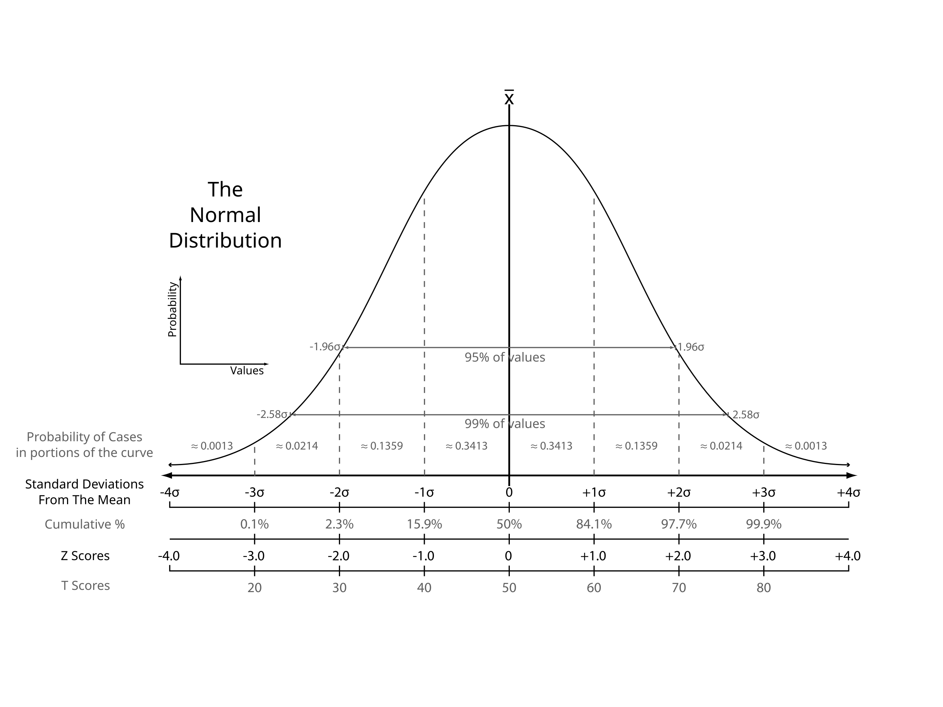

‘How many standard deviations away from mean?’
$$z=\frac{x−μ}{σ},$$
Standardize our X into Z
Look up cumulative area in Z-table
Notes:
We only need the mean and standard deviation to get z scores for any real world value.
Z-scores show where we are on the normal distribution (within the universal template that we have)

Slide 45
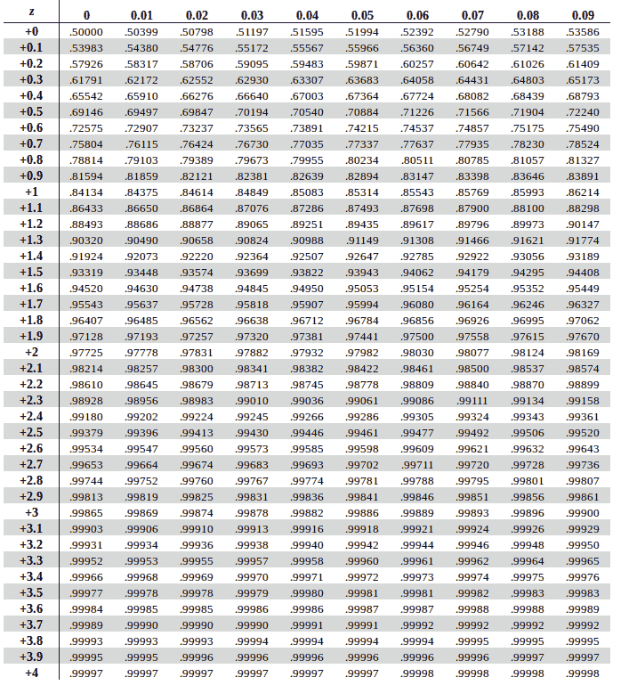
Z-Table (It is a tool. Nobody knows this by heart)
https://www.ztable.net/

Slide 46


Z-scores
$$z=\frac{x−μ}{σ},$$
What is the probability my laptop crashes fewer than 115 times? ($μ$=100, $σ$=10)
Notes:
So what do we do with Z-scores?

Slide 47
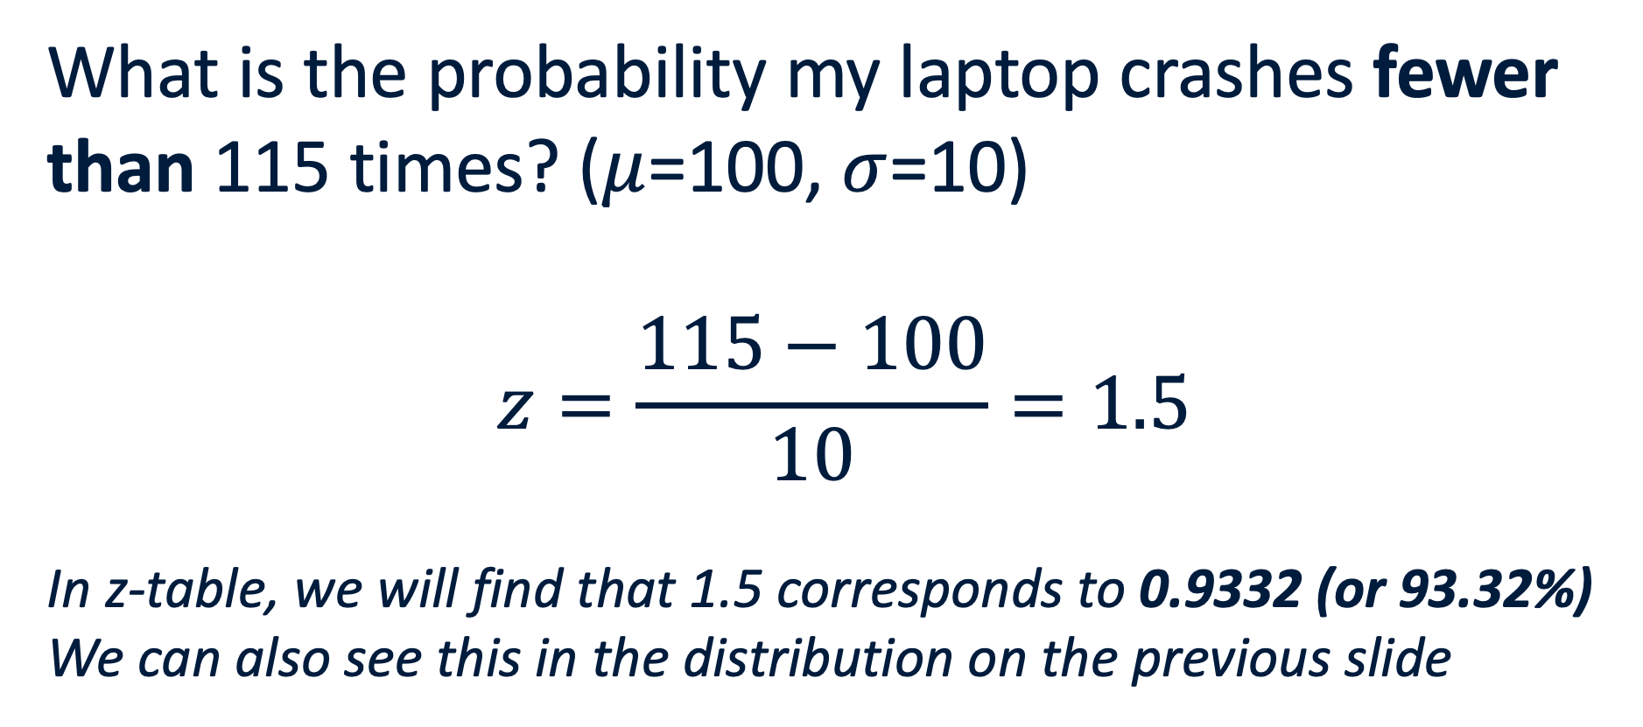
Z-scores
$$z=\frac{x−μ}{σ},$$
What is the probability my laptop crashes fewer than 115 times? ($μ$=100, $σ$=10)
$$z=\frac{115−100}{10}=1.5$$
In z-table, we will find that 1.5 corresponds to 0.9332 (or 93.32%)
We can also see this in the distribution on the previous slide
1.5 standard deviations above the mean
Notes:
We are using cumulative functions. Area under the curve until 115 corvers 0.933

Slide 48
Z-scores
Q: What is the chance of having more than 115 crashes?
A: 1 - P(Z < 1.5) = 1 – 0.9332 = 0.0668 (or 6.68%)
Q: What is the chance the laptop crashes between 90 and 110 times?
A: Find z-score for 90 and z-score for 100.
probability for 110 – probability for 90

Slide 49
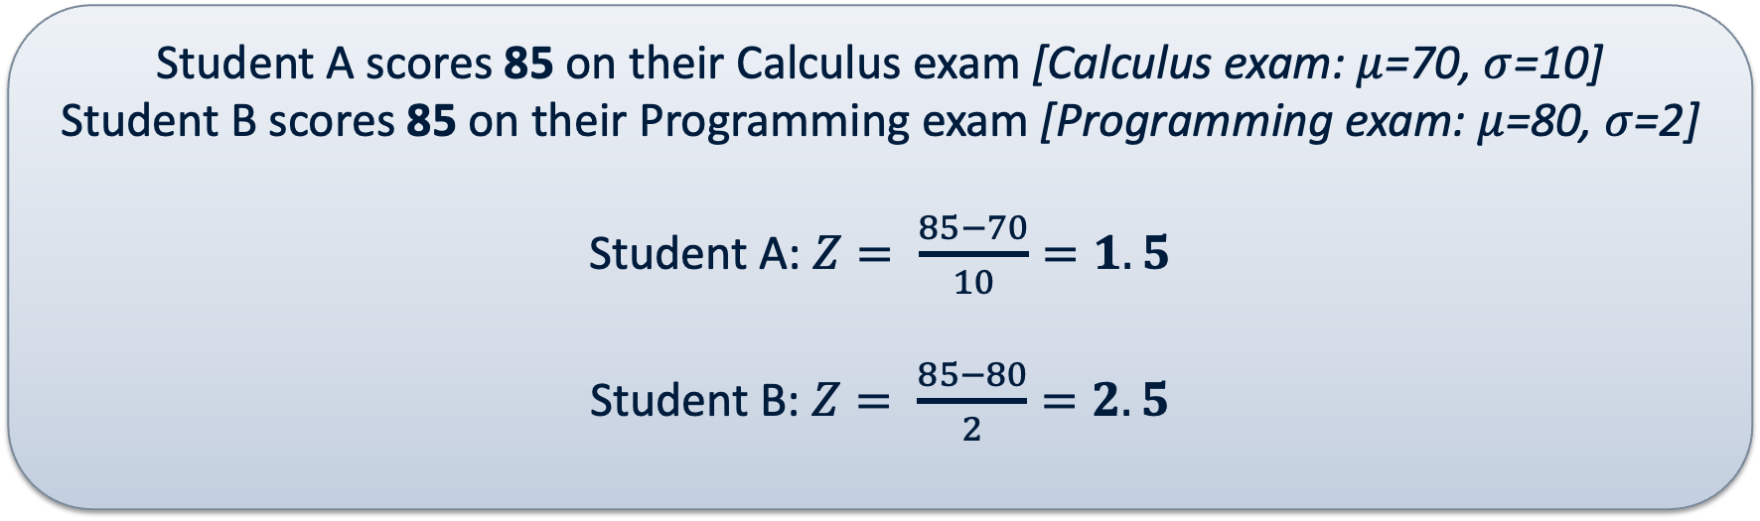
Z-scores
Because z-scores are standardized
We can compare different distributions
Student A scores 85 on their Calculus exam [Calculus exam: $μ$=70, $σ$=10]
Student B scores 85 on their Programming exam [Programming exam: $μ$=80, $σ$=2]
Student A: $Z= \frac{85−70}{10}=1.5$
Student B: $Z= \frac{85−80}{2}=2.5$
Mean
A
B

Slide 50
Distributions are great!
Bernoulli, Binomial, Poisson and Normal
Calculations (E[X], Variance) got easier once we saw the patterns
They allowed us to answer practical questions with probabilities

Slide 51
Coffee?

Slide 52
Why is the Normal Distribution so great?
Law of Large Numbers
Central Limit Theorem
Confidence Intervals
Not magic?!
Notes:
Before the break, I spent a lot of time showing how the normal distribution is a handy tool. Now we will see the why.

Slide 53

Law of Large Numbers
As the number of trials (n) increases, the sample mean ($\overline{x}$) will converge to the theoretical mean ($μ$) of the population.
Notes:
The more we do something, the less fluke crashes matter -> the more the true average number of crashes is revealed over time

Slide 54
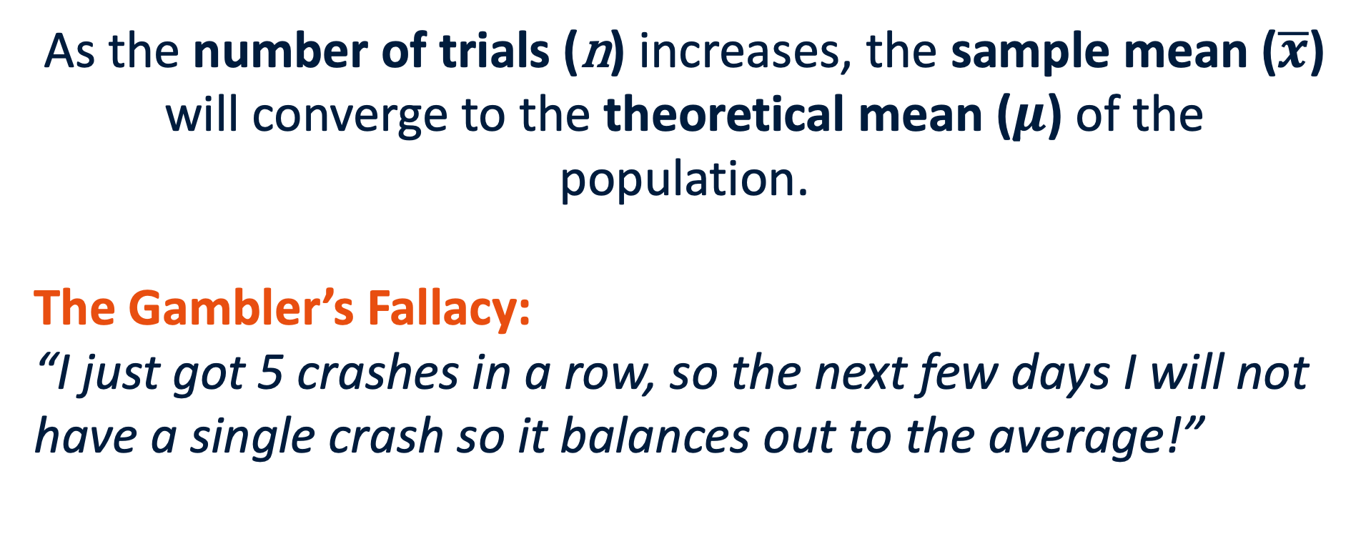
Law of Large Numbers
As the number of trials (n) increases, the sample mean ($\overline{x}$) will converge to the theoretical mean ($μ$) of the population.
The Gambler’s Fallacy:
“I just got 5 crashes in a row, so the next few days I will not have a single crash so it balances out to the average!”
Notes:
Also called Monte Carlo fallacy. Comes from gambling, thinking if you have an early losing streak you will surely win the next time because the average requires a few wins. Right?

Slide 55
Law of Large Numbers
The Gambler’s Fallacy:
“I just got 5 crashes in a row, so the next few days I will not have a single crash so it balances out to the average!”
Only after a very large number of days will these early crashes become mathematically invisible, not directly…
Notes:
The more we do something, the less fluke crashes matter -> the more the true average number of crashes is revealed over time

Slide 56
Central Limit Theorem
The law of large numbers says that the sample mean converges to the population mean as the n increases.
In principle we do not know the distribution, but it looks familiar

Slide 57

Central Limit Theorem
For distributions without very heavy tails, the sample mean converges to the normal [bell curve] distribution with the population mean as its mean (law of large numbers) and standard deviation = $σ/\sqrt{n}$ = population standard error!

Slide 58


Central Limit Theorem: Intuition
We have a skewed die. It gives us a ‘1’ 80% of the time. The other 20% is divided over 2-6.
Our experiment includes 1 roll (n=1). But we perform the experiment many times.
Notes:
CLT

Slide 59

Central Limit Theorem: Intuition
We have a skewed die. It gives us a ‘1’ 80% of the time. The other 20% is divided over 2-6.
Why does the graph change? To get an average of 1 with n=4, we need to throw a 1 each of the 4 times!
Due to the many more combinations possible with 4 throws, the shape changes.
Notes:
It is all because of combinations. Even though we are skewed towards 1, if we throw higher than 1 in even only a single throw, the sample mean already increases higher than 1…

Slide 60

Central Limit Theorem: Intuition
We have a skewed die. It gives us a ‘1’ 80% of the time. The other 20% is divided over 2-6.
Why does the graph change? To get an average of 1 with n=32, we need to throw a 1 each of the 32 times!
Due to the many more combinations possible with 32 throws, the shape changes.
Rings a bell?
Notes:
It is all because of combinations. Even though we are skewed towards 1, if we throw higher than 1 in even only a single throw, the sample mean already increases higher than 1…

Slide 61

The Magic Of CLT

Slide 62
Assumptions of CLT
All random variables are independent.
All random variables come from the same distribution.
The population variance of the random variable is finite and non-zero.
If the probability of throwing a 1 is 100% (zero variance), we will not reach a bell curve

Slide 63

CLT: we deal with averages now
$$σ_{\overline{x}}=\frac{σ}{\sqrt{n}}$$
Standard error
Often shape emerges around 30 trials. Often != always
Spread of the averages
Averages over 32 rolls
Notes:
Averages are much more stable than individual data points. Rolling a 6 is common. Rolling 100 dice and having an average of 6 is very rare. Dividing the std by sqroot(n) corrects this.

Slide 64



CLT: we deal with averages now
$$σ_{\overline{x}}=\frac{σ}{\sqrt{n}}$$
Standard error
Spread of the averages
BEFORE:
$$Z=\frac{x−μ}{σ}$$
$$Z=\frac{\overline{x}−μ}{σ/\sqrt{n}}$$
Thanks to CLT:
Notes:
Averages are much more stable than individual data points. Rolling a 6 is common. Rolling 100 dice and having an average of 6 is very rare. Dividing the std by sqroot(n) corrects this.

Slide 65


Confidence Intervals
Sample average $\overline{x}$will fall within 2 Standard Errors of the true population mean about 95% of the time.
Thanks to CLT:
$$Z=\frac{\overline{x}−μ}{σ/\sqrt{n}}$$
Notes:
Averages are much more stable than individual data points. Rolling a 6 is common. Rolling 100 dice and having an average of 6 is very rare. Dividing the std by sqroot(n) corrects this.

Slide 66
Confidence Interval
If we are able to determine that our sample is close to the truth, then we can also say that the truth must be close to our sample!
Notes:
We flip it around! Thanks to the CLT, we can determine that our sample is close to the truth. But we often do not know the truth. -> We do not include all 8 billion people in each survey we do.
BUT: due to this flip, we can say that our sample gets close to that truth. And we use confidence intervals to show the uncertainty. E.g. 95%

Slide 67
Confidence Interval
If we are able to determine that our sample is close to the truth, then we can also say that the truth must be close to our sample!
Handy because we do not know the truth!
Confidence Intervals
Notes:
Is everyone still on board?

Slide 68


95% confidence interval
Assuming central limit theorem holds: $\overline{x} \sim N\left(μ ,\frac{σ}{\sqrt{n}}\right), \frac{σ}{\sqrt{n}} called Standard Error$
If we want the range within which, 95 times out of a 100, our sample mean will cover the population mean, we calculate:
$\overline{x} ±1.96 ∗STD_{\overline{x}}$ =
$[\overline{x}−1.96 ∗ \frac{σ}{\sqrt{n}}$ , $\overline{x}+1.96 ∗ \frac{σ}{\sqrt{n}}$ ]

Slide 69


95% confidence interval
Assuming central limit theorem holds: $\overline{x} \sim N\left(μ ,\frac{σ}{\sqrt{n}}\right), \frac{σ}{\sqrt{n}} called Standard Error$
If we want the range within which, 95 times out of a 100, our sample mean will cover the population mean, we calculate:
$\overline{x} ±1.96 ∗STD_{\overline{x}}$ =
$[\overline{x}−1.96 ∗ \frac{σ}{\sqrt{n}}$ , $\overline{x}+1.96 ∗ \frac{σ}{\sqrt{n}}$ ]
$$z_{\frac{α}{2}}$$
$$z_{0.025} = −1.96$$
$$z_{0.975} = 1.96$$
Notes:
If we go back to the normal distribution plot on slide 64, you can see the z-scores around the orange field. Approx 1.96 and -1.96 to capture the middle 95% (so not the first 2.5% and the last 2.5%, since 2.5+2.5=5)

Slide 70


Slide 71

Confidence Intervals in practice
As you know by now, my laptop crashes a lot. I want to estimate the population mean ($μ$) of crashes for this laptop model over 250 days. I can't test every single laptop the company made, but I can afford 36 laptops.
My sample
Notes:
What information do we need for our confidence interval calculation?

Slide 72

Confidence Intervals in practice
As you know by now, my laptop crashes a lot. I want to estimate the population mean ($μ$) of crashes for this laptop model over 1 year. I can't test every single laptop the company made, but I can afford 36 laptops.
I found an average of 105 crashes over 1 year
Manufacturer claims$: σ= 12$
My sample
Notes:
How do we construct the 95% interval?

Slide 73




Confidence Intervals in practice
As you know by now, my laptop crashes a lot. I want to estimate the population mean ($μ$) of crashes for this laptop model over 250 days. I can't test every single laptop the company made, but I can afford 36 laptops.
I found an average of 105 crashes over 1 year
Manufacturer claims$: σ= 12$
$[\overline{x}−1.96 ∗ \frac{σ}{\sqrt{n}}$ , $\overline{x}+1.96 ∗ \frac{σ}{\sqrt{n}}$ ]
$$\text{SE}=\frac{σ}{\sqrt{n}}=\frac{12}{\sqrt{36}}=\frac{12}{6}=2.0$$
1. Standard error:
2. Margin of error:
$$\text{ME}=Z × \text{SE}=1.96 × 2.0=3.92$$
3. 95% CI:
$$\left[105−3.92,105+3.92\right]=\left[101.08,108.92\right]$$

Slide 74

Confidence Intervals in practice
As you know by now, my laptop crashes a lot. I want to estimate the population mean ($μ$) of crashes for this laptop model over 250 days. I can't test every single laptop the company made, but I can afford 36 laptops.
I found an average of 105 crashes over 1 year
Manufacturer claims$: σ= 12$
$$\left[101.08,108.92\right]$$
We found that with 95% certainty, the true average number of crashes in a year falls within 101.08 and 108.92.
So if the manufacturer claims that their laptops would only crash on average 80 times a year, we have reason to doubt that claim.
Notes:
The more data we have, the narrower our intervall becomes. Because we have more and more input. Mathematically, this happens through the division of sqrt(n) when calculating the standard error. If n grows, the denominator grows as well.

Slide 75
Why confidence intervals?
If we knew every single true population mean, we would not need statistics in the first place…
We admit that our sample might be slightly off, but we calculate that we are close enough to the truth.
Notes:
How close?

Slide 76
Why confidence intervals?
If we knew every single true population mean, we would not need statistics in the first place…
We admit that our sample might be slightly off, but we calculate that we are close enough to the truth.
How close? So close that 95 out of 100 times, our interval will capture the true mean!
Notes:
We can adjust the 95% to show more or less confidence. We can adjust the Z in our formula with a z score for 90% certainty, or to be even more precise, 99% certainty. This will impact our interval size of course. If we need to be less certain, we have more wiggle room, we can be more free so the interval can be narrower (because we need to be less certain, we are willing to be more wrong). If we need to be more certain (e.g. 99% certain), the interval becomes wider because we have to be more careful

Slide 77
But what if my data is limited?
Small datasets exists (e.g. n<30?)
Notes:
When n is small, it becomes hard to assume the mean is close to a normal distribution and thus the use of the standard error becomes uncertain

Slide 78


But what if my data is limited?
Small datasets exists (e.g. n<30?)
$σ$ is a population parameter, not from our samples. In practice, we do not know population parameters
But what if I don’t know $σ$?
Otherwise we would probably also know the true population average ($μ)$?
Notes:
When n is small, it becomes hard to assume the mean is close to a normal distribution and thus the use of the standard error becomes uncertain

Slide 79

But what if my data is limited?
When trying to estimate the standard error for a small dataset, we need to estimate the standard deviation, which can have more error (farther from population parameter) as a result.
To make up for this, rather than use a z-score $(z_{\frac{α}{2}})$ we instead use a t-score that comes from a bell-like distribution with thicker tails.
Notes:
When n is small, it becomes hard to assume the mean is close to a normal distribution and thus the use of the standard error becomes uncertain

Slide 80

T-distribution & William Gossett
Every morning at a Guinness factory, William Gossett took a tiny scoop from a giant vat of fermenting beer, ran three or four chemical tests, and – based on those handful of observations – had to decide whether the entire batch would become world-class beer or waste.
Why only a few measurements?
Each test destroyed the sample.
Results were needed quickly, before the batch spoiled.
One test took a whole day to run.
How reliable is a decision when n = 3 or 4?
Notes:
Guinness forbade staff from publishing commercial know-how, so Gosset smuggled the paper into Biometrika (1908) under the pseudonym “Student.”
He sent the manuscript to his friend Karl Pearson on his lunch break; Pearson mis-addressed the acceptance letter to “Student, Esq.” – the name stuck.

Slide 81

T-distribution
For n = 3 or 4, the normal distribution is a very poor approximation to the sampling distribution to the mean.
Gossett derived the true distribution when we want to estimate:
$T=\frac{\overline{x} −μ}{\frac{S}{\sqrt{n}}}$
which is appropriate when we need to estimate both the mean and the standard deviation for small samples.

Slide 82
t-Distribution
A common Guinness conundrum: Reject a 100-barrel brew if any stain of acid above 1.8 g L⁻¹ in three tests.
Using the normal z-score of 1.96 ended up scrapping 10% of perfectly fine vats (the good value was outside the confidence interval).
But the t-Distribution critical value of 4.30 ensured that false alarms were limited to only 5%.
Notes:
The t-distribution was born because one brewer wanted to save good stout from the drain. Every time you see a ‘± * t*’ margin of error, you’re tapping a century-old pint raised to rigorous decision-making under scarcity.
The funny thing is that the way the t-distribution is used now is kind of in reverse, the reality is that we WANT to scrap the original expectation (think for example of a drug trial) so that difference in intent is worth keeping in mind.

Slide 83

t-Distribution Definition
t-Distribution
t- Distribution is bell-shaped and for a mean of 0, is symmetric about 0. Probability depends on the number of samples which guides the degrees of freedom (df = samples -1) of the distribution. Has thicker tails and more variability as a result than the normal. Can get a better sense for confidence in smaller samples, that is, we can be more sure our sample parameter estimate and interval captures the population parameter estimate using the $t−score$ multiplied by the standard error.

Slide 84


T-distribution
In the t-table, we see that t-value is dependent on:
1) sample size
(degrees of freedom = n-1)
2) Alpha
95% confidence ->
$$α = 0.05$$
Notes:
The idea is the same, only the tails of the distribution are thicker. So we build in more safety

Slide 85
T-distribution
As n increases, t-value decreases toward 1.96 (closer and closer to z-value and normal distribution)
Notes:
The idea is the same, only the tails of the distribution are thicker. So we build in more safety

Slide 86

T-Distribution

Slide 87
Is it fair to assume a normal distribution?
Using the t-distribution is actually robust.
(1) you can’t tell if you have a normal distribution when you have small samples and
(2) even if it isn’t, the t-Dist. gives confidence intervals that tends to capture the population.
Robust Statistical Method
﻿A statistical method is said to be robust with respect to a particular assumption if it performs adequately even when that assumption is modestly violated.
Notes:
A big problem in statistics in assumptions which is why its great to have in your toolbox ways to not make assumptions when analyzing data.

Slide 88
When does the t-distribution not work?
Data are not independently generated.
Data has some extreme outliers.

Slide 89


Back to my laptop… (for the 100th time)
Sample mean ($\overline{x}$): 105 (crashes)
Sample Standard Deviation (s): 12
Sample size (n): 5 (laptops)
Degrees of freedom (df): n-1 = 5 – 1 = 4
In t-table, we find a t-score with 95% confidence for df=4: 2.776
Notes:
We do not need a single population parameter. As in a practical context, those are most probably unknown
Now I can only afford 5 laptops… not 36 like before

Slide 90




Back to my laptop… (for the 100th time)
Sample mean ($\overline{x}$): 105 (crashes)
Sample Standard Deviation (s): 12
Sample size (n): 5 (laptops)
$$\text{SE}=\frac{s}{\sqrt{n}}→\frac{12}{\sqrt{5}}≈5.37$$
$$105±\left(2.776 × 5.37\right)$$
$$105 ±14.9$$
t=2.776
95% CI: [90.1, 119.9]
$$\text{Interval}=\overline{x}±\left(t × \text{SE}\right)$$
Notes:
Start is the mean
The multiplier is t -? Depends on n-1 and confidence (e.g. 95%)
Spread is captured by s/srt(n)
Logic behind it: since sample is small, our multiplier (t) is quite large (2.776 vs 1.96 for z). This builds in ore safety, the net is larger for capturing the true population average.

Slide 91


CI for proportions (binary outcomes)
Means:
$$SE=\frac{s}{\sqrt{n}}$$
Proportions:
$$SE=\sqrt{\frac{\hat{p}\left(1−\hat{p}\right)}{n}}$$
If we measured a percentage, we know the spread.
e.g. 50% said True, then 100-50 said False

Slide 92





Confidence Interval for Proportion of a Single Sample
If $n$ is large and $\hat{p}$is not too close to 0 or 1 ($n\hat{p}, n\left(1−\hat{p}\right)>5$), then
$σ$is estimated accurately by $\hat{p} (1−\hat{p})$.
The sampling distribution of $p$ can be approximated with a normal distribution ($\hat{p}$ is treated a$s a classical mean)$
$$\hat{p}$$
$p$
0.2
0.4
0.6
0.8
Proportion of Happy Customers
$$P\left(p∈[\hat{p}±z_{α/2} \sqrt{\frac{\hat{p}\left(1−\hat{p}\right)}{n}}]\right)≈1−α$$

Slide 93

Confidence Interval for Proportion of a Single Sample
If in an exit poll we see that 53.8 % of 3889 people voted for one candidate then we get:
$SD=\frac{\sqrt{\hat{p}}\left(1−\hat{p}\right)}{n} =\frac{\sqrt{0.538}∗√0.462}{3889}$ = 0.008 ~0.01
Suggests that CI is 51.6 to 55.8% for $α=0.05$.
$$\hat{p}$$
$p$
0.2
0.4
0.6
0.8
Proportion of Happy Customers
$$P\left(p∈[\hat{p}±z_{α/2} \sqrt{\frac{\hat{p}\left(1−\hat{p}\right)}{n}}]\right)≈1−α$$

Slide 94
Recap: from Binomial to Poisson

Slide 95
Recap: from Poisson to Normal
Notes:
Think about the CLT in this case. Bell curve emerges also for poisson or binomial. E.g. 1 hour window is a sum of 60 minute windows etc. Proportions are an average of multiple binary 1’s and 0’s

Slide 96
Recap: Z (normal) or t (t-distribution)?

Slide 97
Recap: Confidence Intervals

Slide 98
Questions?

